Slide 1


JERSEY 2017
OLDFIELDS HALL MIDDLE SCHOOL
FOOTBALL & NETBALL TOUR

Slide 2
JERSEY 2017
I have organised and led 9 Sports tours over the past 12 years.
This will be our 6th sports tour at Oldfields
Previously we have been to:
Malta 2012
Dublin 2013
London 2014
Isle of Man 2015
Isle of Man 2016
All have been different, but all have been really enjoyable for the pupils and staff

Slide 3
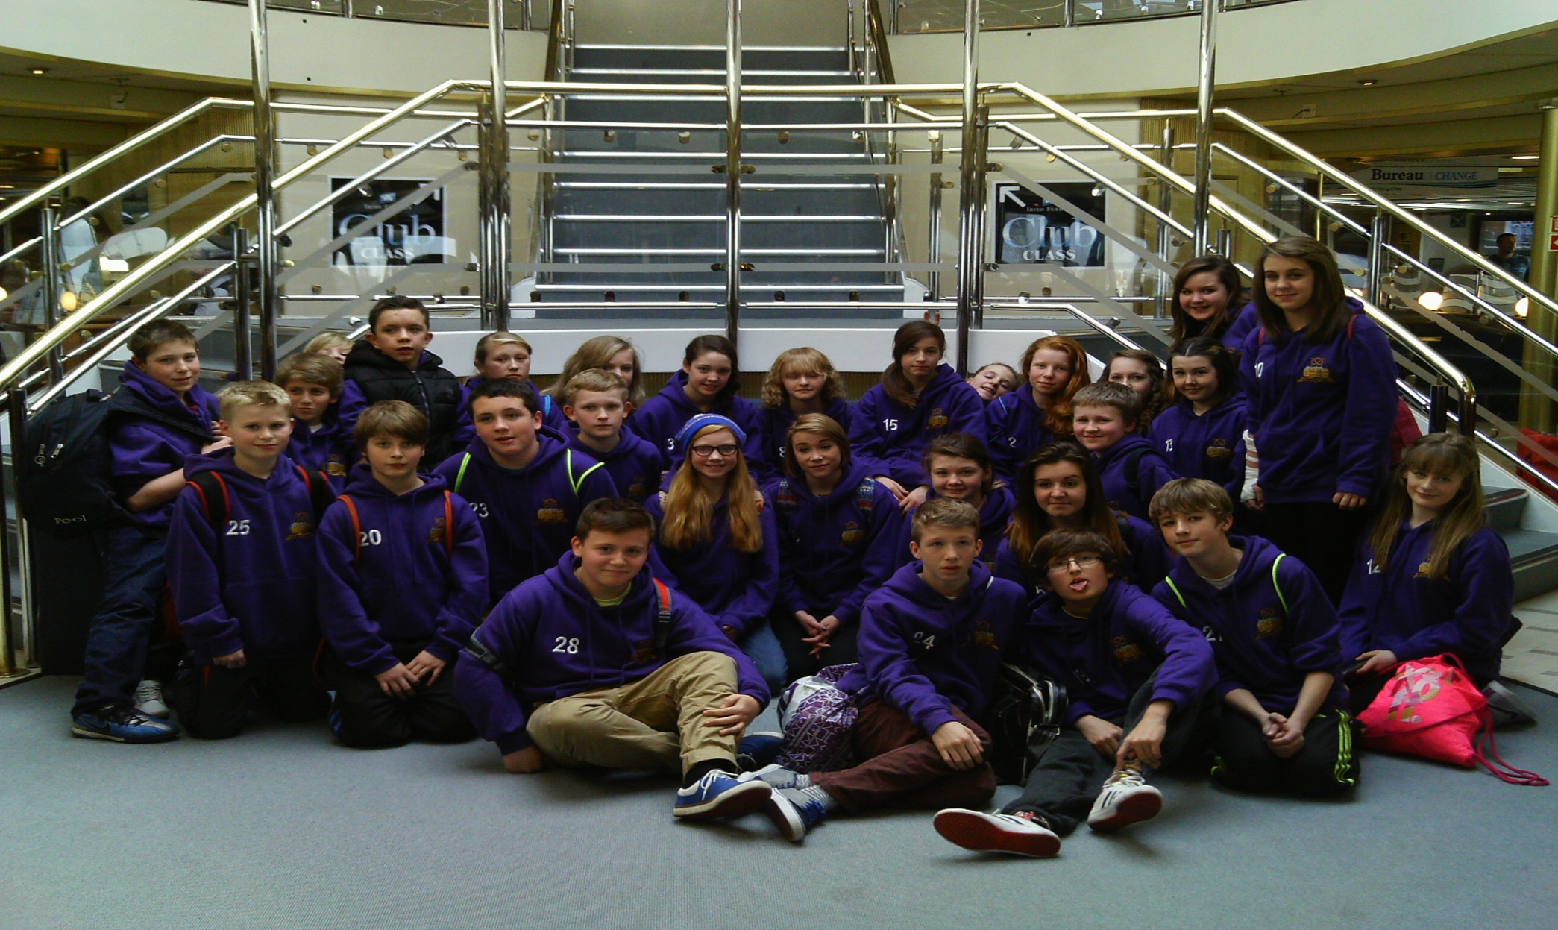
DUBLIN 2013

Slide 4
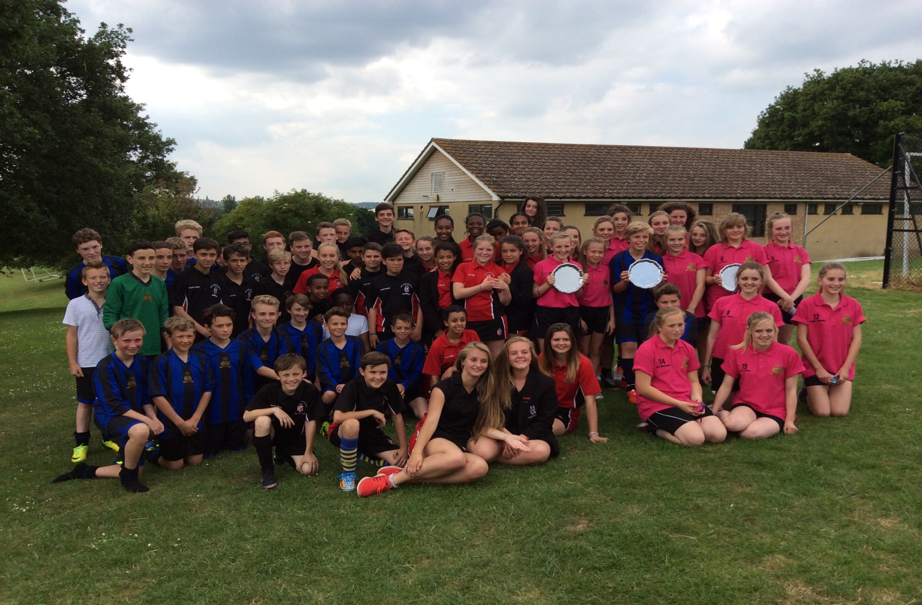
LONDON 2014

Slide 5
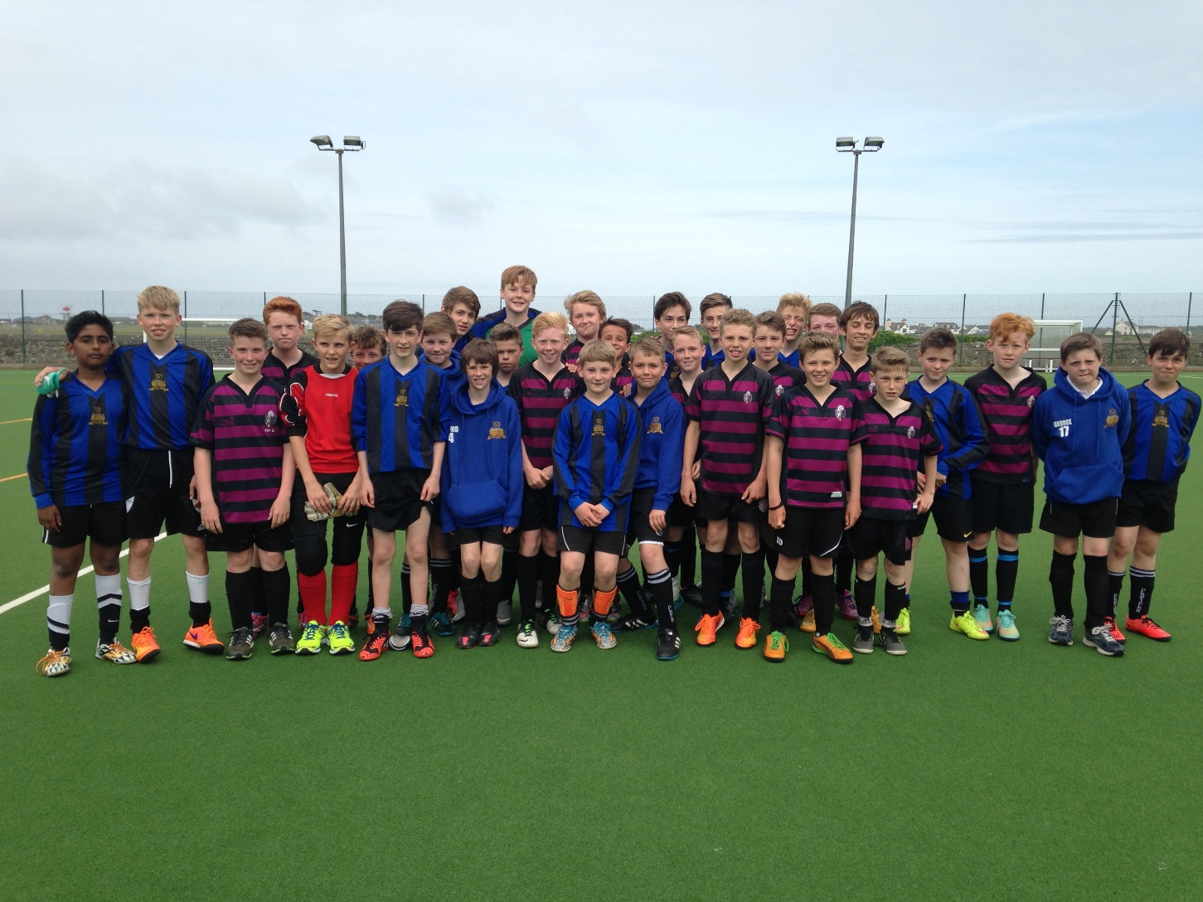
ISLE OF MAN 2015

Slide 6
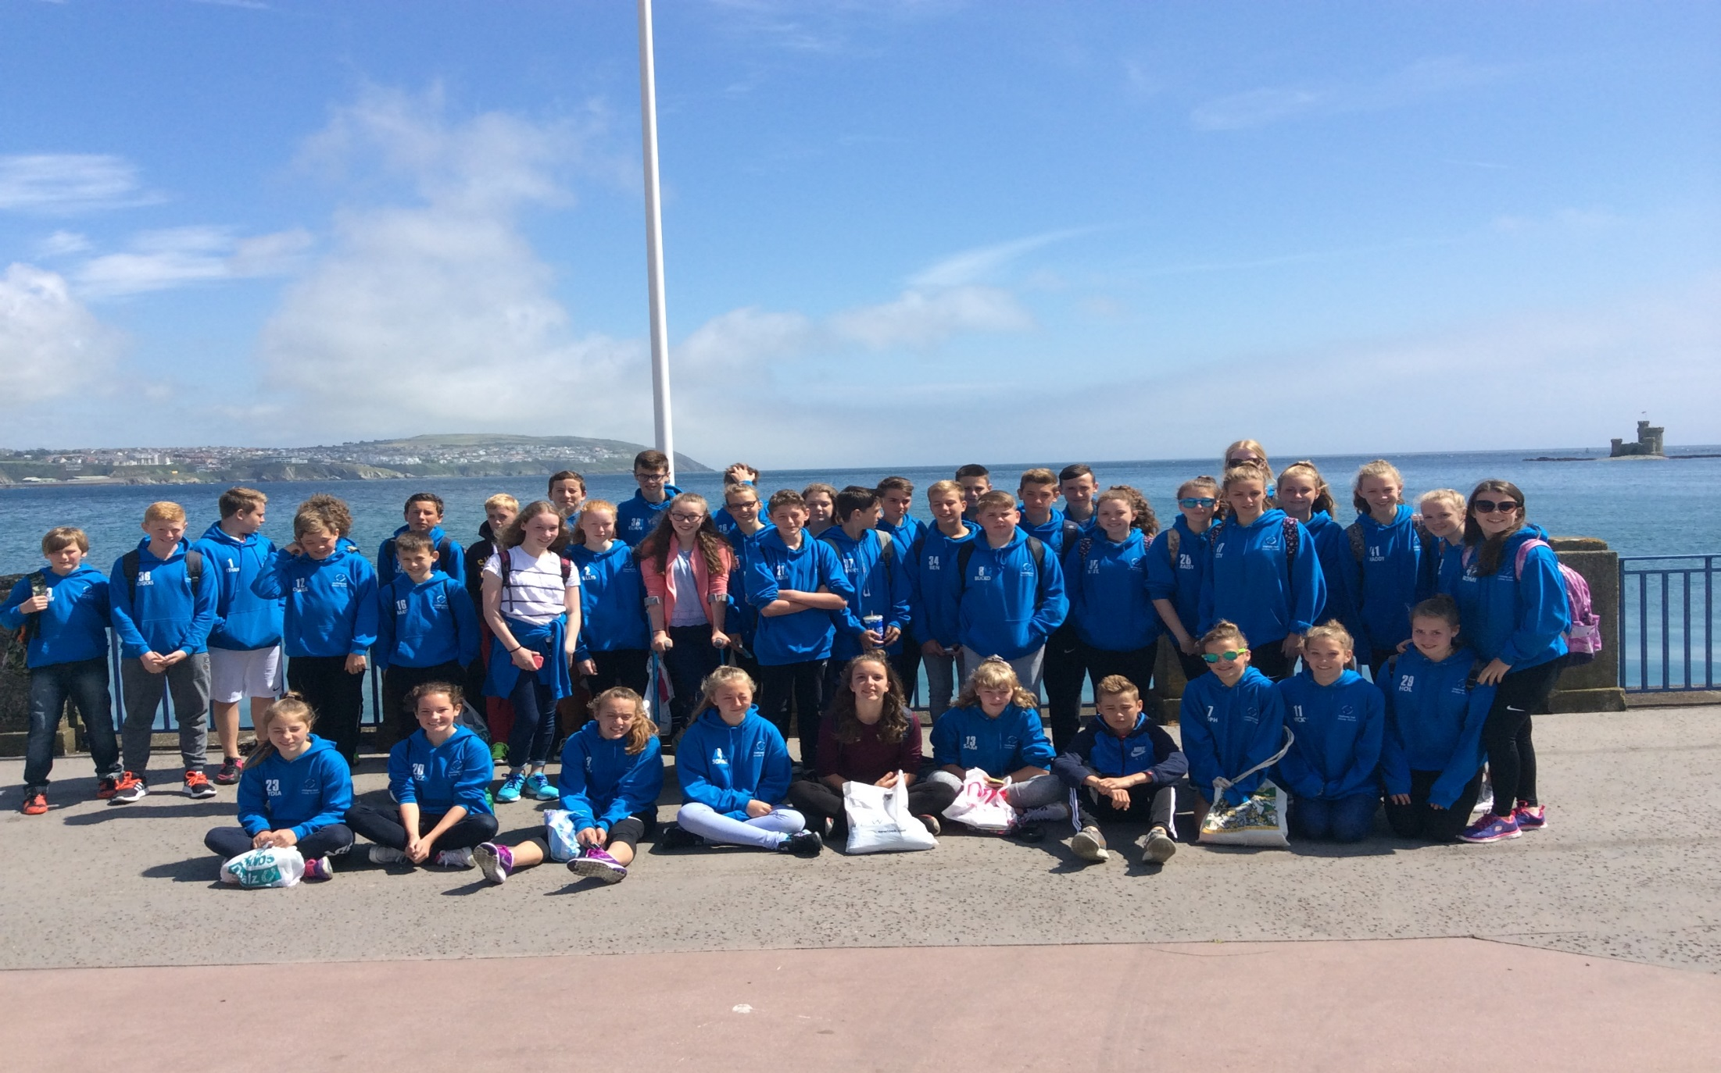
ISLE OF MAN 2016

Slide 7
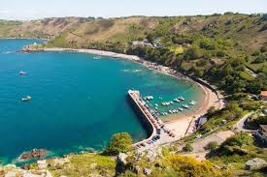


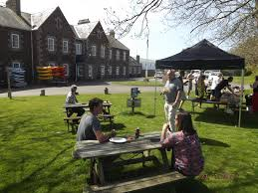
JERSEY 2017

Slide 8
1 | KANE ALLSUP
2 | ASHTON BAGLEY
3 | JESS BANNER
4 | FERN BEAUMONT
5 | GEORGE BEECH
6 | CHLOE BENNETT
7 | IMOGEN BEST
8 | FREYA BETTANY
9 | ALICE BOOTHBY
10 | SAM BROWN
11 | JED BRUNT
12 | ETHAN BUNGAR
13 | HOLLY CHATFIELD
14 | THEO CLAYTON
15 | HARRY COPE
16 | AARON CURTIS
17 | MYA DAIN
18 | OWEN EVANS
19 | LILY GANNING
20 | AMELIA HADGETT

Slide 9
21 | FREYA HADGETT
22 | KIAN HALL
23 | SEB HANCOX
24 | JASMINE HARDISTY
25 | WILL HOCKING
26 | JACK HOOKER MYLES
27 | WILL JAKES
28 | CAITLIN JONES
29 | REUBEN KENNY
30 | EMILY MARSLAND
31 | KAMRON MCCUTCHEON
32 | REUBEN NICHOLLS
33 | AMIE RENSHAW
34 | MATT RICHARDSON
35 | EVIE SIDWELL
36 | HOLLY SUTTON
37 | FRANKIE TOOTH
38 | HARRY VAN HOEK
39 | ISOBEL WATTS
40 | JACOB WHITE
41 | JAKE WILDRIDGE

Slide 10
JERSEY 2017
THE STAFF
42 MISS MERRICK
43 MRS KIRK
44 MR HALES
45 MR SKINNER
46 MR MORRIS

Slide 11
JERSEY 2017
ITINERARY
DAY 1 – TUESDAY 20TH JUNE
Depart Oldfields at 8.45am (JST coach)
Check in at 11am at Liverpool airport
Fly at 1pm – flight number EZY7023
Arrive in Jersey @ 2.10pm
Transfer to accommodation
Spend some time settling in and unpacking
4pm – transfer to Aquasplash
Dinner at accommodation
Evening at our leisure

Slide 12

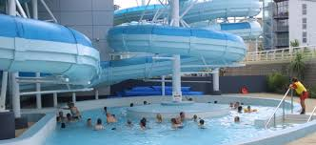
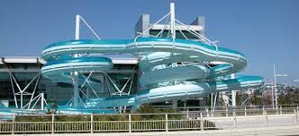
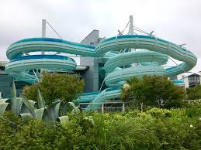

Slide 13
JERSEY 2017
DAY 2 – WEDNESDAY 21st JUNE
Breakfast
First set of fixtures:
Netball – A, B and C teams (3 games) V TBC
Football – A & B teams (2 games) V Hautee Vallee School (St Hellier)
Packed lunches
Back to the accommodation for dinner
Disco at the accommodation

Slide 14
JERSEY 2017
DAY 3 – THURSDAY 22nd JUNE
• Breakfast
Second set of fixtures:
Netball – A, B and C teams (3 games) V Les Quennevais School
Football – A & B teams (2 games) V Le Rocquier School
Packed lunches
In the afternoon we will be doing some beach games including kayaking and SUP boarding (ran by the centre staff)
Evening at our leisure

Slide 15

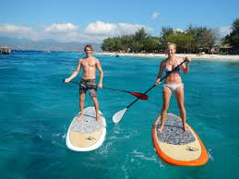

Slide 16
JERSEY 2017
DAY 4 – FRIDAY 23RD JUNE
• Breakfast
Check out of rooms
We will take a walk to Long Beach in Gorey and spend some time in Gorey Harbour where there are various cafes and shops
3.30pm – transfer to airport
6pm – depart on flight EZY7022
7.05pm - arrive into Liverpool airport
9.30pm approx. arrive back at Oldfields.
Will ask pupils to text/ring if this time differs or I can contact you using the school mobile.

Slide 17
Accommodation
We are staying in Jersey Accomodation & activity centre, similar set up to Standon Bowers.
Dormitory style rooms mainly
Separate bathrooms for each dorm
TV room
Perfect surroundings to play sport and relax in free time and very safe
Close to the beach!!
Coach travel throughout

Slide 18

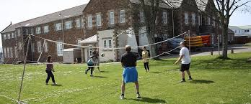
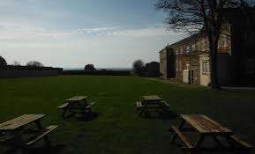

Slide 19
JERSEY 2017
EXPECTATIONS
LISTEN TO INFORMATION
BE ON TIME – 5 MINUTES EARLY!
WHEN WE SAY ITS BEDTIME – GO TO BED! YOU WILL NEED THE REST
BE RESPECTFUL TO ALL STAFF AND LOCAL PEOPLE
BE RESPECTFUL TO YOUR PEERS
LOOK AFTER YOUR THINGS – ITS YOUR RESPONSIBILITY

Slide 20
JERSEY 2017
SPENDING MONEY
I would suggest taking around £5 - £10 a day spending money
This can buy you drinks and the odd snack if required!
If you want to take more you can but you wont have time to spend much!
On the first day a packed lunch will be needed and/or some money to buy food at services/airport
It is your responsibility to look after your own money

Slide 21
JERSEY 2017
PACKING LIST – SPORTS CLOTHING
Max of 20KG and a small hand luggage bag
Black shorts
Black football socks
T shirt for under netball bib
Black netball skirt
Football boots & trainers/moulds/blades – football played on astro and grass
Trainers
Shin pads
Drinks bottle – provided (squad number on)
Football shirts and netball bibs will be provided – We will give you the shirt or bib the Monday before we leave so you can pack it.

Slide 22
JERSEY 2017
PACKING LIST – CASUAL CLOTHING
Your hoody! Must be worn when we travel – easy to identify everyone in motorway services and in the airport/plane, etc.
Some casual clothing
A couple of towels
Swimwear
You wont need loads!!
Toiletries – please put all these in your main bag – makes things easier than carrying in your hand luggage (volume restrictions)
No liquids to be left in your hand luggage – bottles of water for example must be drank before you go through security or will be taken off you and thrown away.
If you bring any electrical items such as phones, ipads, etc – they are for you to look after and be responsible for
Any medication you want us to look after – please give it to us on day of departure in a clear bag, named and details written on.

Slide 23
JERSEY 2017
HOTEL DETAILS AND IMPORTANT NUMBERS
There is a card provided with all info on for you to take home
There is also a small red card with the mobile number on I will have with me at all times for the pupils to use if they need to

Slide 24
JERSEY 2017
HOTEL DETAILS AND IMPORTANT NUMBERS
Jersey accommodation and activity centre, Rue de la Pouclee et des quatre Chemins, Faldouet, St Martin. JE3 4DU.
Phone number – +44 1534 498636
My mobile number – 07544225208
Oldfields Hall contact – 01889 562770

Slide 25
DEPARTURE DAY
Please be at Oldfields by 8.30am at the latest! So we can leave at 8.45am (ish)
Meet in the bus park
Please make sure you have your ID in your hand luggage. We will check we have it all before we leave! No ID = No travel!

Slide 26
JERSEY 2017
ANY QUESTIONS???
THIS WHOLE POWERPOINT WILL BE ON THE SCHOOL WEBSITE - SPORTS TOUR 2017
ALSO SHEETS AVAILABLE WITH PACKING LIST, ITINERARY, ETC
PLEASE TAKE BOTH INFORMATION CARDS HOME
PLEASE TAKE THE 2 CONSENT FORMS AND EITHER FILL OUT NOW OR TAKE HOME AND RETURN TO ME BY FRIDAY PLEASE
THANK YOU FOR COMING TONIGHT
LETS HAVE A GREAT TRIP!!

